Slide 1

Project presentation on:
Conversion of Sign Language to Text
Presented by :
Vijay Adhikari (1900950100086)
Vineet Kumar Sharma (1900950100089)
Navneet Kumar Singh (1900950100086)
Paras ((1900950100051)
Under the Guidance of :
Navin Kumar Trivedi
DEPARTMENT OF COMPUTER SCIENCE & ENGINEERING
MGM’s College of Engineering & Technology, Noida
05,April, 2023

Slide 2

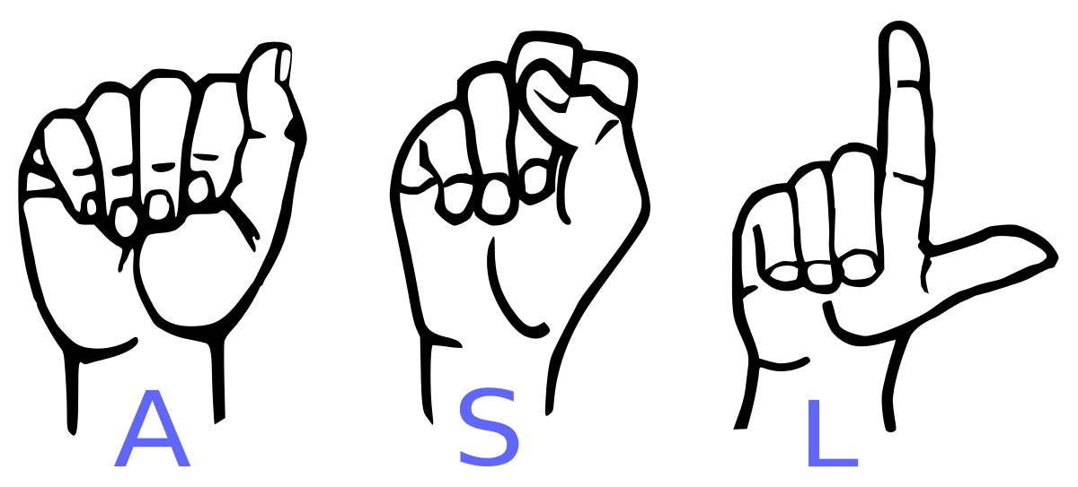
Conversion of Sign Language to Text
For Dumb and Deaf

Slide 3
Introduction
American sign language is a predominant sign language Since the only disability D&M people have is communication related and they cannot use spoken languages hence the only way for them to communicate is through sign language. Communication is the process of exchange of thoughts and messages in various ways such as speech, signals, behavior and visuals. Deaf and dumb(D&M) people make use of their hands to express different gestures to express their ideas with other people. Gestures are the nonverbally exchanged messages and these gestures are understood with vision. This nonverbal communication of deaf and dumb people is called sign language.

Slide 4
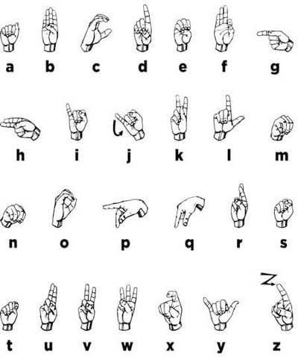
In our project we will basically focus on producing a model which can recognize Fingerspelling based hand gestures in order to form a complete word by combining each gesture. The gestures we aim to train are as given in the image below.

Slide 5
Literature review
In the recent years there has been tremendous research done on the hand gesture recognition.
With the help of literature survey done we realized the basic steps in hand gesture recognition are :-
● Data acquisition
● Data preprocessing
● Feature extraction
● Gesture classification

Slide 6

Data acquisition:
We are going to use vision based method in which computer camera is the input device for observing the information of hands or fingers. The Vision Based methods require only a camera, thus realizing a natural interaction between humans and computers without the use of any extra devices. These systems tend to complement biological vision by describing artificial vision systems that are implemented in software and/or hardware. The main challenge of vision-based hand detection is to cope with the large variability of human hand’s appearance due to a huge number of hand movements, to different skin-color possibilities as well as to the variations in view points, scales, and speed of the camera capturing the scene.

Slide 7
In the approach for hand detection combines threshold-based color detection with background subtraction. We can use AdaBoost face detector to differentiate between faces and hands as both involve similar skin-color.
We can also extract necessary image which is to be trained by applying a filter called Gaussian blur. The filter can be easily applied using open computer vision also known as OpenCV.
Data preprocessing and Feature extraction for vision
based approach:

Slide 8
Gesture classification :
According to paper on “Human Hand Gesture Recognition Using a Convolution Neural Network” by Hsien-I Lin , Ming-Hsiang Hsu, and Wei-Kai Chen graduates of Institute of Automation Technology National Taipei University of Technology Taipei, Taiwan, they construct a skin model to extract the hand out of an image and then apply binary threshold to the whole image. After obtaining the threshold image they calibrate it about the principal axis in order to center the image about it. They input this image to a convolutional neural network model in order to train and predict the outputs. They have trained their model over 7 hand gestures and using their model they produce an accuracy of around 95% for those 7 gestures.

Slide 9
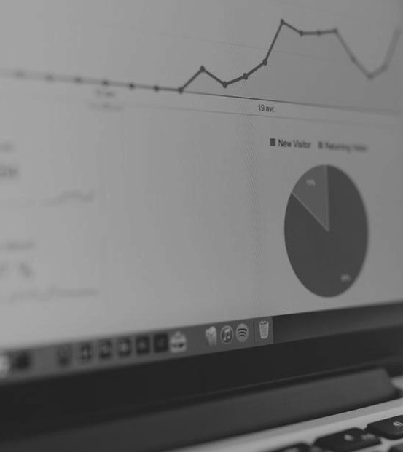
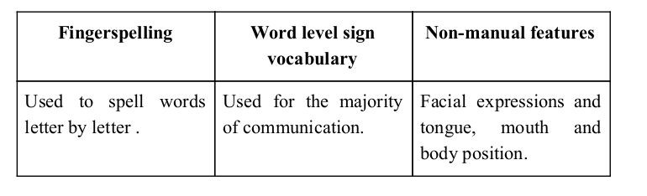
Sign language is a visual language and consists of 3 major components:

Slide 10
GAPS IN LITERATURE
Most of the research papers focus on using devices like kinect for hand detection but our main aim is to create a project which can be used with readily available resources. A sensor like kinect not only isn’t readily available but also is expensive for most of audience to buy and our model uses a normal webcam of the laptop hence it is great plus point.
A recognition model is built using hidden Markov model classifier and a vocabulary of 30 words and they achieve an error rate of 10.90%.

Slide 11
OBJECTIVE
The aim is to develop a user friendly human computer interfaces (HCI) where the computer understands the human sign language.
With the help of a normal webcam available on a device we can translate different signs into text.
This will help D&M people to communicate with others.

Slide 12
methodology
Firstly create a data set of different sign images captured through the device attached to the system.
Then process the images and apply Gaussian blur and thresholding on the image
Train the program on these images and prepare proper modules

Slide 13
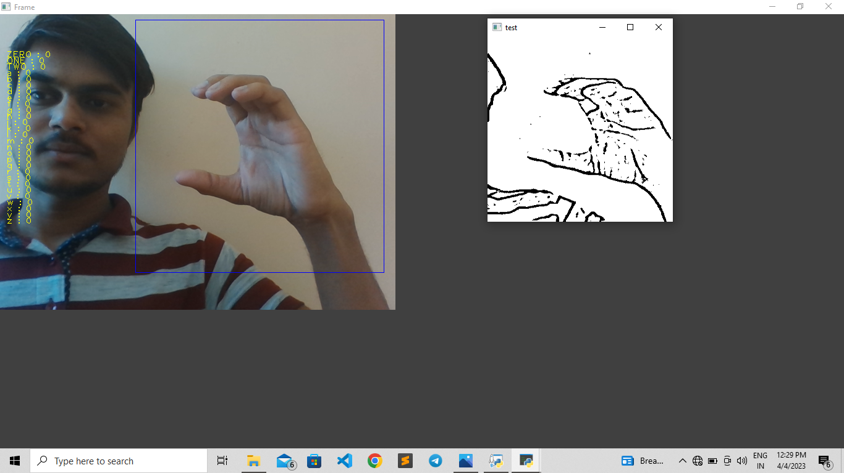
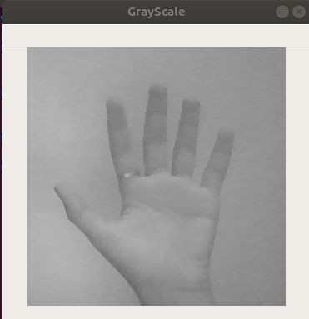
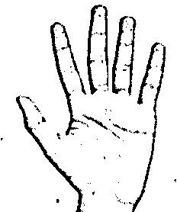
Image Post Gaussian Blur
How we generated data set and did Data Preprocessing ?
Capturing Raw Image
Gray Scale Image

Slide 14
Why we Created our own Dataset ?
For the project we tried to find already made datasets but we couldn’t
Find dataset in the form of raw images that matched our requirements.
All we could find were the datasets in the form of rgb values.
Hence we decided to create our own data set.

Slide 15
Layer 1
SIGN CLASSIFICATION
Layer 2
Classify between Similar Symbols
Classify between 27 Symbols

Slide 16
modules Requirements

Slide 17
Dataset creation
First we capture each frame shown by the webcam of our machine. In each frame we define a region of interest (ROI) which is denoted by a blue bounded square as shown in the image below.
From this whole image we extract our ROI which is RGB and convert it into gray scale Image as shown below.
Finally, we apply our Gaussian blur filter to our image which helps us extracting various features of our image.

Slide 18
Training of dataset
We convert our input images(RGB) into grayscale and apply Gaussian blur to remove unnecessary noise. We apply adaptive threshold to extract our hand from the background and resize our images to 128 x 128.
We feed the input images after preprocessing to our model for training and testing after applying all the operations mentioned above. The prediction layer estimates how likely the image will fall under one of the classes.
So the output is normalized between 0 and 1 and such that the sum of each values in each class sums to 1. We have achieved this using softmax function.

Slide 19
At first the output of the prediction layer will be somewhat far from the actual value. To make it better we have trained the networks using labeled data.
The cross-entropy is a performance measurement used in the classification. It is a continuous function which is positive at values which is not same as labeled value and is zero exactly when it is equal to the labeled value.
Therefore, we optimized the cross-entropy by minimizing it as close to zero. To do this in our network layer we adjust the weights of our neural networks. TensorFlow has an inbuilt function to calculate the cross entropy.
As we have found out the cross entropy function, we have optimized it using Gradient Descent

Slide 20
Gesture Classification
1st Convolution Layer: - The input picture has resolution of 128x128 pixels. It is first processed in the first convolutional layer using 32 filter weights (3x3 pixels each). This will result in a 126X126 pixel image, one for each Filter-weights.
1st Pooling Layer: - The pictures are down sampled using max pooling of 2x2 i.e. we keep the highest value in the 2x2 square of array. Therefore, our picture is down sampled to 63x63 pixels.
2nd Convolution Layer: - Now, these 63 x 63 from the output of the first pooling layer is served as an input to the second convolutional layer. It is processed in the second convolutional layer using 32 filter weights (3x3 pixels each). This will result in a 60 x 60-pixel image.

Slide 21
2nd Pooling Layer: - The resulting images are down sampled again using max pool of 2x2 and is reduced to 30 x 30 resolution of images.
1st Densely Connected Layer: - Now these images are used as an input to a fully connected layer with 128 neurons and the output from the second convolutional layer is reshaped to an array of 30x30x32 = 28800 values. The input to this layer is an array of 28800 values. The output of these layer is fed to the 2nd Densely Connected Layer. We are using a dropout layer of value 0.5 to avoid overfitting.
2nd Densely Connected Layer: - Now the output from the 1st Densely Connected Layer are used as an input to a fully connected layer with 96 neurons.
Final layer: - The output of the 2nd Densely Connected Layer serves as an input for the final layer which will have the number of neurons as the number of classes we are classifying (alphabets + blank symbol).

Slide 22
SOFTWARE Requirements
Python
Convolutional Neural Network
OpenCV
Numpy
TensorFlow

Slide 23
conclusion
In this report, a functional real time vision based American sign language recognition for D&M people have been developed for asl alphabets.
We achieved an accuracy of 95.7% on our dataset.
Prediction has been improved after implementing two layers of algorithms in which we verify and predict symbols which are more similar to each other.

Slide 24
References :
T. Yang, Y. Xu, and “A. , Hidden Markov Model for Gesture Recognition”, CMU-RI-TR-94 10, Robotics Institute, Carnegie Mellon Univ. , Pittsburgh, PA, May 1994.
https://docs.opencv.org/2.4/doc/tutorials/imgproc/gausian_median_blur_b
aeshpande3.github.io/A-Beginner%27s-Guide-To-Understanding-Convolutional-Neural-Networks-Part-2/ilateral_filter/gausian_median_blur_bilateral_filter.html
https://en.wikipedia.org/wiki/Convolutional_neural_network
https://opencv.org/

Slide 25
Thank You !

